Slide 1
TIP!
Keep animation in place Replace Logo’s by right clicking image and choose “Change Picture…”

Slide 2

Story time

Slide 3


Illia Lebid
IT Engineer at ABN AMRO
Working on iDeal 2.0

Slide 4


TIP!
Keep animation in place Replace Logo’s by right clicking image and choose “Change Picture…”
Full proof testing
A guide to stable application

Slide 5
Types of tests
Unit
Contracts
Functional
Memory leakage
E2E
Snapshots
Accessibility
Security
Performance
Code quality
Mutation

Slide 6



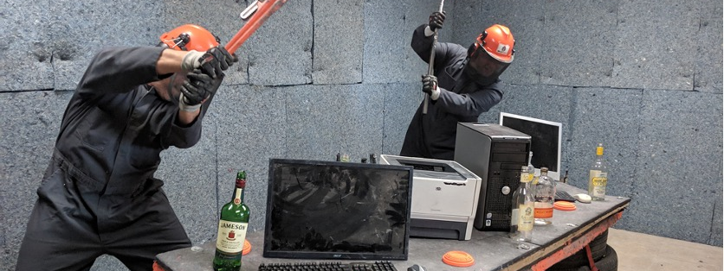

Testing Pyramid
Traceability matrix
Test driven development
Breaking the tests
Integration with the pipeline

Slide 7
Traceability matrix
Testing Pyramid
Test driven development
Breaking the tests
Integration with the pipeline

Slide 8
Manual
Testing pyramid
Functional
Static
(Performance, Security, Code quality, Mutation, Memory leakage, Contracts, Accessibility, Snapshots)
E2E
Unit

Slide 9
Manual
Testing pyramid
Functional
Static
(Performance, Security, Code quality, Mutation, Memory leakage, Accessibility, Snapshots)
E2E
Unit

Slide 10
Manual
Testing pyramid
Functional
Static
(Performance, Security, Code quality, Mutation, Memory leakage, Accessibility, Snapshots)
E2E
Unit
(and maybe Contracts)

Slide 11
Manual
Testing pyramid
Functional
Static
(Performance, Security, Code quality, Mutation, Memory leakage, Accessibility, Snapshots)
E2E
Unit
(and maybe Contracts)

Slide 12
Manual
Testing pyramid
Functional
Static
(Performance, Security, Code quality, Mutation, Memory leakage, Accessibility, Snapshots)
E2E
Unit
(and maybe Contracts)

Slide 13
Manual
Testing pyramid
Functional
Static
(Performance, Security, Code quality, Mutation, Memory leakage, Accessibility, Snapshots)
E2E
Unit
(and maybe Contracts)

Slide 14
Traceability matrix
Testing Pyramid
Test driven development
Breaking the tests
Integration with the pipeline

Slide 15
Testing Pyramid
Traceability matrix
Test driven development
Breaking the tests
Integration with the pipeline

Slide 16

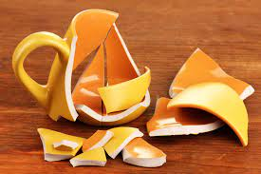

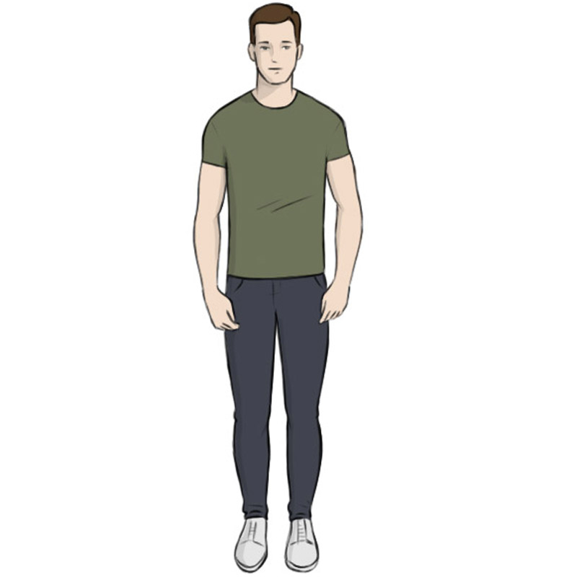


Traceability matrix
Actions | Expected result | Is tested
 |  | YES
 |  | NO

Slide 17
Testing Pyramid
Traceability matrix
Test driven development
Breaking the tests
Integration with the pipeline

Slide 18
Testing Pyramid
Traceability matrix
Test driven development
Breaking the tests
Integration with the pipeline

Slide 19
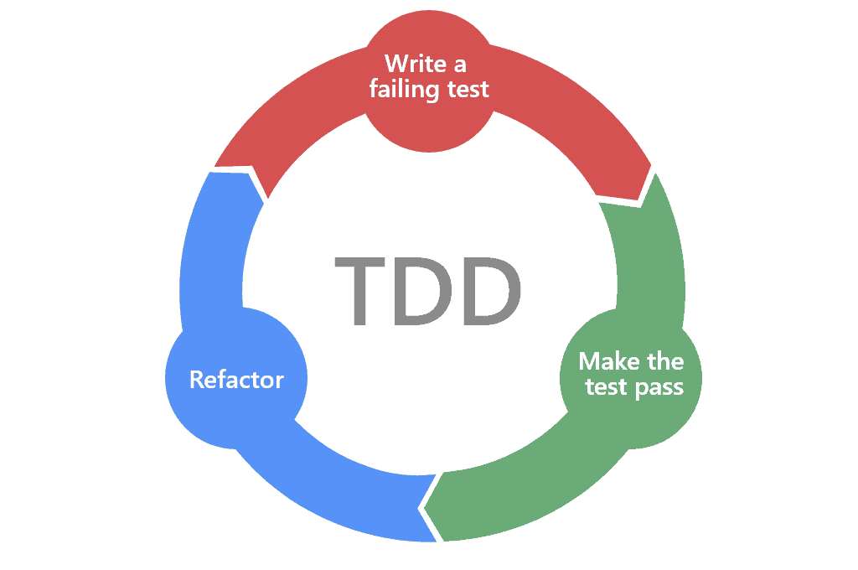
Test driven development

Slide 20
Testing Pyramid
Traceability matrix
Test driven development
Breaking the tests
Integration with the pipeline

Slide 21
Testing Pyramid
Traceability matrix
Test driven development
Breaking the tests
Integration with the pipeline

Slide 22
Testing Pyramid
Traceability matrix
Test driven development
Breaking the tests
Integration with the pipeline

Slide 23
Integration with the pipeline

Slide 24
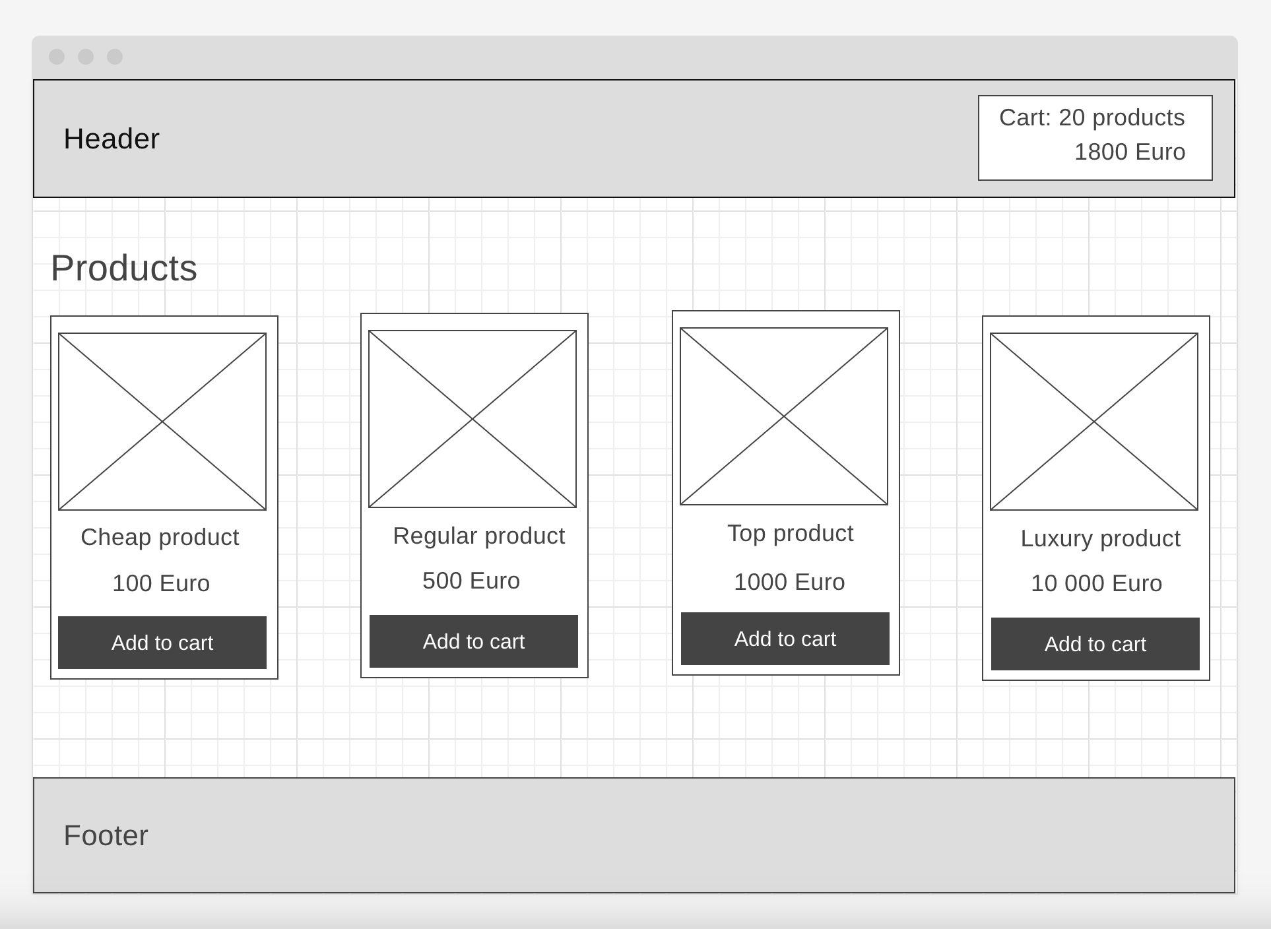
Example time

Slide 25
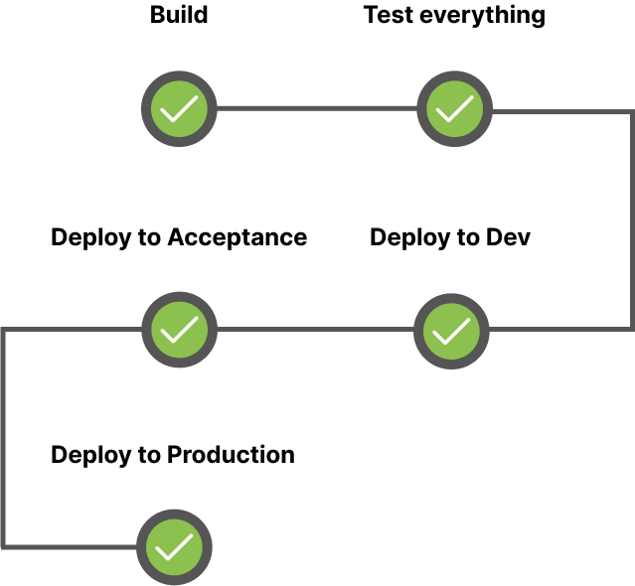

Pipeline and static tests

Slide 26
Traceability matrix (Catalog)
Actions | Expected result | Is tested
User opens catalog | List of products is shown | NO
User doesn’t have any product in the cart | Header cart shows no products | NO
User adds several products to the product cart | Header cart counter and total price is updated | NO
User adds products on price higher than 1000Euro | Header cart applies 10% discount | NO
Backend responds with error | Error modal is shown with correct message | NO

Slide 27
Traceability matrix (Product cart)
Actions | Expected result | Is tested
User opens product cart | List of user’s cart products is shown | NO
User opens product cart | Total price is shown | NO
Products cart’s total price is higher than 1000 | 10% discount is applied to total price | NO
User increases amount of product items in cart | Total price is updated | NO
User decreases amount of product items in cart | Total price is updated | NO
Update total price is higher/lower than 1000 | 10% discount is enabled/disabled | NO
User refreshes page | Cart changes are persisted | NO
Backend responds with error | Error modal with correct message is shown | NO

Slide 28
Traceability matrix (Checkout)
Actions | Expected result | Is tested
User opens checkout | Checkout form is displayed | NO
User doesn’t fill anything in checkout and submits the form | Validation messages are displayed. Form is not submitted. | NO
User fills everything correct and receives error response from the backend | Error messages are displayed. | NO
User fills everything correctly and receives success response from the backend | Payment page is shown | NO

Slide 29
Traceability matrix (Payment)
Actions | Expected result | Is tested
User opens payments page | Correct price and product details are displayed | NO
User pays and he has enough money | Payment is successful | NO
User pays and he doesn’t have enough money | An error is shown, payment is not made | NO
User tries again after failed attempt and he has enough money | Payment is successful. Success page is shown | NO
User pays and he has enough money | Payment is successful. Success page is shown | NO
User pays and he receives unexpected error response from the backend | An error is shown, payment is not made | NO

Slide 30


Example (Unit testing)
function calculateDiscount(price) {
}
It should:
Give 0% discount if price is less than 1000
Give 10% discount if price is more than 1000
Throw an error if price is not provided
> calculateDiscount(10)
undefined

Slide 31

Example (Unit testing)
function calculateDiscount(price) {
return price;
}
It should:
Give 0% discount if price is less than 1000
Give 10% discount if price is more than 1000
Throw an error if price is not provided
> calculateDiscount(10)
10

Slide 32
Example (Unit testing)
function calculateDiscount(price) {
return price;
}
It should:
Give 0% discount if price is less than 1000
Give 10% discount if price is more than 1000
Throw an error if price is not provided
> calculateDiscount(5000)
5000

Slide 33
Example (Unit testing)
function calculateDiscount(price) {
if(price >= 1000) return price * 0.1;
return price;
}
It should:
Give 0% discount if price is less than 1000
Give 10% discount if price is more than 1000
Throw an error if price is not provided
> calculateDiscount(5000)
4500

Slide 34
Example (Unit testing)
function calculateDiscount(price) {
if(price >= 1000) return price * 0.1;
return price;
}
It should:
Give 0% discount if price is less than 1000
Give 10% discount if price is more than 1000
Throw an error if price is not provided
> calculateDiscount()
undefined

Slide 35
Example (Unit testing)
function calculateDiscount(price) {
if(!price) throw new Error('PriceIsARequiredParameter’);
if(price >= 1000) return price * 0.1;
return price;
}
It should:
Give 0% discount if price is less than 1000
Give 10% discount if price is more than 1000
Throw an error if price is not provided
> calculateDiscount()
Uncaught error: PriceIsARequiredParameter

Slide 36
Example (Unit testing)
function calculateDiscount(price) {
if(!price) throw new Error('PriceIsARequiredParameter’);
if(price >= 1000) return price * 0.1;
return price;
}
It should:
Give 0% discount if price is less than 1000
Give 10% discount if price is more than 1000
Throw an error if price is not provided
> calculateDiscount('Free')
Free

Slide 37
Example (Unit testing)
function calculateDiscount(price) {
if(!price) throw new Error('PriceIsARequiredParameter’);
if(price >= 1000) return price * 0.1;
return price;
}
It should:
Give 0% discount if price is less than 1000
Give 10% discount if price is more than 1000
Throw an error if price is not provided
Throw an error if price is not a number
> calculateDiscount('Free')
Free

Slide 38
Example (Unit testing)
function calculateDiscount(price) {
if(typeof price === 'number') {
throw new Error(PriceMustBeNumber’);
}
if(!price) throw new Error('PriceIsARequiredParameter’);
if(price >= 1000) return price * 0.1;
return price;
}
It should:
Give 0% discount if price is less than 1000
Give 10% discount if price is more than 1000
Throw an error if price is not provided
Throw an error if price is not a number
> calculateDiscount('Free')
Uncaught error: PriceIsARequiredParameter

Slide 39
Example (Unit testing)
function calculateDiscount(price) {
if(typeof price === 'number') {
throw new Error(PriceMustBeNumber’);
}
if(!price) throw new Error('PriceIsARequiredParameter’);
if(price >= 1000) return price * 0.1;
return price;
}
It should:
Give 0% discount if price is less than 1000
Give 10% discount if price is more than 1000
Throw an error if price is not provided
Throw an error if price is not a number
> calculateDiscount(1000)
900

Slide 40
Example (Unit testing)
function calculateDiscount(price) {
if(typeof price === 'number') {
throw new Error(PriceMustBeNumber’);
}
if(!price) throw new Error('PriceIsARequiredParameter’);
if(price > 1000) return price * 0.1;
return price;
}
It should:
Give 0% discount if price is less than 1000
Give 10% discount if price is more than 1000
Throw an error if price is not provided
Throw an error if price is not a number
> calculateDiscount(1000)
1000

Slide 41
Example (Unit testing)
function calculateDiscount(price) {
if(typeof price === 'number') {
throw new Error(PriceMustBeNumber’);
}
if(!price) throw new Error('PriceIsARequiredParameter’);
if(price > 1000) return price * 0.1;
return price;
}
It should:
Give 0% discount if price is less than 1000
Give 10% discount if price is more than 1000
Throw an error if price is not provided
Throw an error if price is not a number
Give 10% discount if price is 1000
> calculateDiscount(1000)
1000

Slide 42
Example (Unit testing)
function calculateDiscount(price) {
if(typeof price === 'number') {
throw new Error(PriceMustBeNumber’);
}
if(!price) throw new Error('PriceIsARequiredParameter’);
if(price >= 1000) return price * 0.1;
return price;
}
It should:
Give 0% discount if price is less than 1000
Give 10% discount if price is more than 1000
Throw an error if price is not provided
Throw an error if price is not a number
Give 10% discount if price is 1000
> calculateDiscount(1000)
900

Slide 43
Functional tests
Happy Flow (Without discount. Including validation)
Happy Flow (With discount)
Error flow (Catalog)
Error flow (Cart)
Error flow (Checkout)
Error flow (Payment)

Slide 44
Functional tests (Happy flow)
test('Happy Flow', async () => {
await Catalog.loadPage();
});

Slide 45
Functional tests (Happy flow)
test('Happy Flow', async () => {
await Catalog.loadPage();
await Catalog.displaysProducts();
});

Slide 46
Functional tests (Happy flow)
test('Happy Flow', async () => {
await Catalog.loadPage();
await Catalog.displaysProducts();
await HeaderCart.shows('No products’);
});

Slide 47
Functional tests (Happy flow)
test('Happy Flow', async () => {
await Catalog.loadPage();
await Catalog.displaysProducts();
await HeaderCart.shows('No products’);
await Catalog.addProductToCart('Cheap Product’);
await HeaderCart.shows('1 product', '100Euro’);
});

Slide 48
Functional tests (Happy flow)
test('Happy Flow', async () => {
await Catalog.loadPage();
await Catalog.displaysProducts();
await HeaderCart.shows('No products’);
await Catalog.addProductToCart('Cheap Product’);
await HeaderCart.shows('1 product', '100Euro’);
await Catalog.addProductToCart('Cheap Product’);
await Catalog.addProductToCart('Cheap Product’);
await HeaderCart.shows('3 products', '300Euro’);
});

Slide 49
Functional tests (Happy flow)
test('Happy Flow', async () => {
await Catalog.loadPage();
await Catalog.displaysProducts();
await HeaderCart.shows('No products’);
await Catalog.addProductToCart('Cheap Product’);
await HeaderCart.shows('1 product', '100Euro’);
await Catalog.addProductToCart('Cheap Product’);
await Catalog.addProductToCart('Cheap Product’);
await HeaderCart.shows('3 products', '300Euro’);
await HeaderCart.goToCart();
await Cart.showsProducts();
await Cart.showsTotalPrice('300Euro’);
});

Slide 50
Functional tests (Happy flow)
test('Happy Flow', async () => {
await Catalog.loadPage();
await Catalog.displaysProducts();
await HeaderCart.shows('No products’);
await Catalog.addProductToCart('Cheap Product’);
await HeaderCart.shows('1 product', '100Euro’);
await Catalog.addProductToCart('Cheap Product’);
await Catalog.addProductToCart('Cheap Product’);
await HeaderCart.shows('3 products', '300Euro’);
await HeaderCart.goToCart();
await Cart.showsProducts();
await Cart.showsTotalPrice('300Euro’);
await Cart.decreaseProductAmount('Cheap Product’);
await Cart.decreaseProductAmount('Cheap Product’);
await Cart.increaseProductAmount('Cheap Product');
await Cart.showsTotalPrice(‘100Euro’);
});

Slide 51
Functional tests (Happy flow)
test('Happy Flow', async () => {
await Catalog.loadPage();
await Catalog.displaysProducts();
await HeaderCart.shows('No products’);
await Catalog.addProductToCart('Cheap Product’);
await HeaderCart.shows('1 product', '100Euro’);
await Catalog.addProductToCart('Cheap Product’);
await Catalog.addProductToCart('Cheap Product’);
await HeaderCart.shows('3 products', '300Euro’);
await HeaderCart.goToCart();
await Cart.showsProducts();
await Cart.showsTotalPrice('300Euro’);
await Cart.decreaseProductAmount('Cheap Product’);
await Cart.decreaseProductAmount('Cheap Product’);
await Cart.increaseProductAmount('Cheap Product');
await Cart.showsTotalPrice(‘100Euro’);
await Cart.goToCheckout();
await Checkout.fillUserData();
await Checkout.submitForm();
await Payment.pay(); await Success.showsSuccess();
});

Slide 52
E2E tests
Happy Flow

Slide 53


Q&Abbb
My LinkedIn https://www.linkedin.com/in/illia-lebid

